Slide 1




RecyclerView &
Adapter
Session 5
Mobile Community Solution

Slide 2



Learning Outcome
Android Concept
and Java Language
UI Component
and Main Features
Demonstrate
and Construct an App

Slide 3
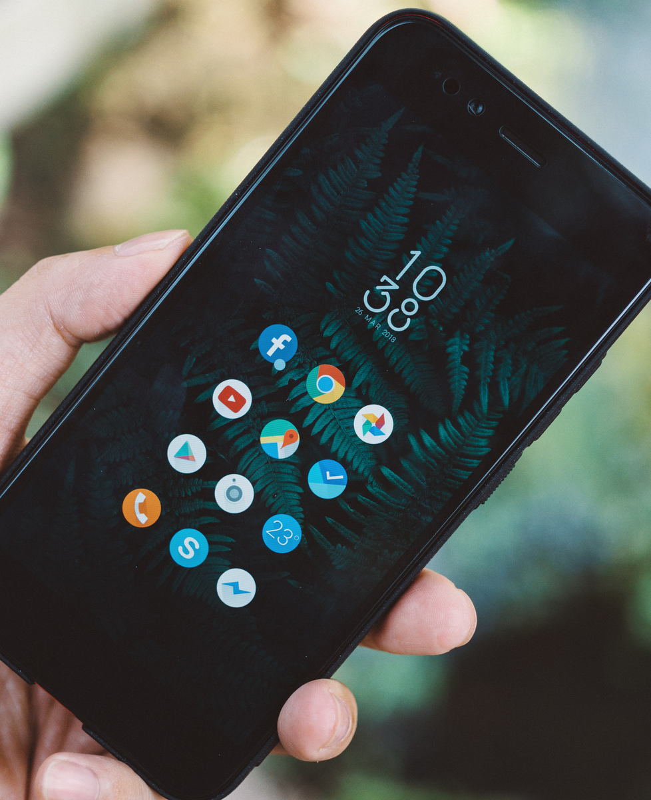
Today's
Session
Recycler View
Recycler View Component
Implementing Recycler View

Slide 4
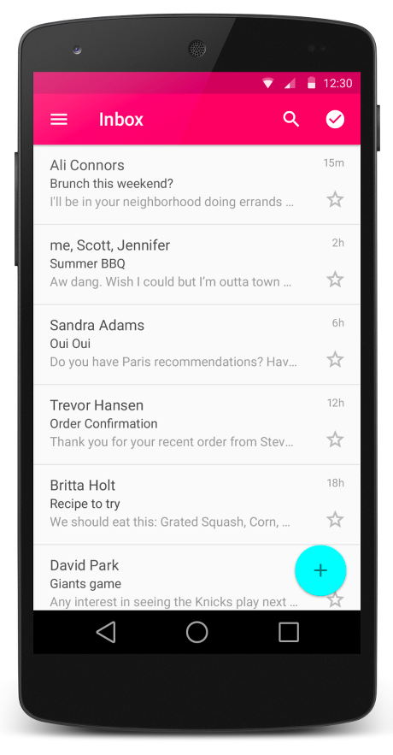
RecyclerView
Is a scrollable container.
Introduced in Marshmallow as the successor of GridView and ListView.
Efficiently display large sets of data.

Slide 5
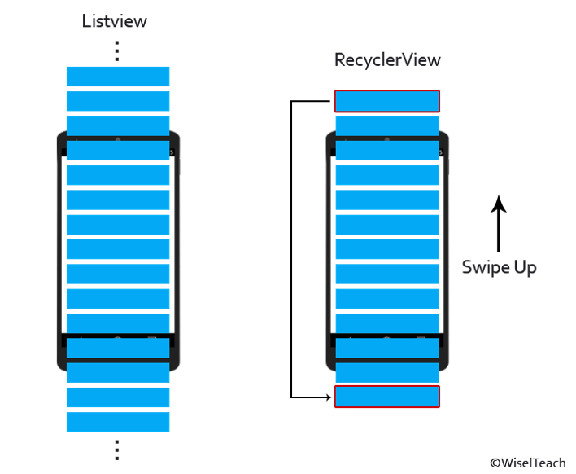
Unlike traditional ListView, RecyclerView improve the efficiency by recycling the views which are out of the visibility of the user.

Slide 6
The Components
In general, RecyclerView consist of three sub-parts:
The Card Layout, the XML layout which will be treated as an item for the list.
The ViewHolder, stores the reference to the card layout views.
The Data Class, the structure for holding the information for every item of the RecyclerView.

Slide 7
Components Breakdown
RecyclerView - Scrolling list for list items.
XML File - Layout for one item of data.
RecyclerView.LayoutManager - handle the organization of UI components.
RecylcerView.Adapter - connects data to the RecyclerView.
RecyclerView.ViewHolder - view information for displaying one item.
Data

Slide 8
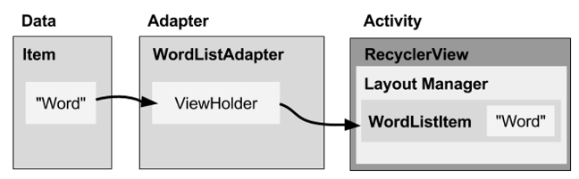
How It Works
Notes:
- recyclerview mengambil data menggunakan adapter
- adapter bukan bawaan android sehingga harus di code secara manual dan menyesuaikan dengan data.
- item berada pada recyclerview menggunakan layout.

Slide 9
Layout Manager
Inside RecyclerView
Reuse view item that are no longer visible to the user.
RecyclerView.LayoutManager
Notes:
- recyclerview mengambil data menggunakan adapter
- adapter bukan bawaan android sehingga harus di code secara manual dan menyesuaikan dengan data.
- item berada pada recyclerview menggunakan layout.

Slide 10
Adapter
Intermediary between data and view
Manages CRUD view item as underlying data changes
RecyclerView.Adapter
Notes:
- recyclerview mengambil data menggunakan adapter
- adapter bukan bawaan android sehingga harus di code secara manual dan menyesuaikan dengan data.
- item berada pada recyclerview menggunakan layout.

Slide 11
ViewHolder
Prepare one view with data for one list item
Layout specified in an XML resource file
Can have clickable elements
RecyclerView.ViewHolder
Notes:
- recyclerview mengambil data menggunakan adapter
- adapter bukan bawaan android sehingga harus di code secara manual dan menyesuaikan dengan data.
- item berada pada recyclerview menggunakan layout.

Slide 12
Implementation
Add dependency to build.gradle
Add RecyclerView to layout
Create XML layout for item
Extend RecyclerView.Adapter
Extend RecyclerView.ViewHolder
In Activity onCreate(), create RecyclerView with adapter and layout manager

Slide 13
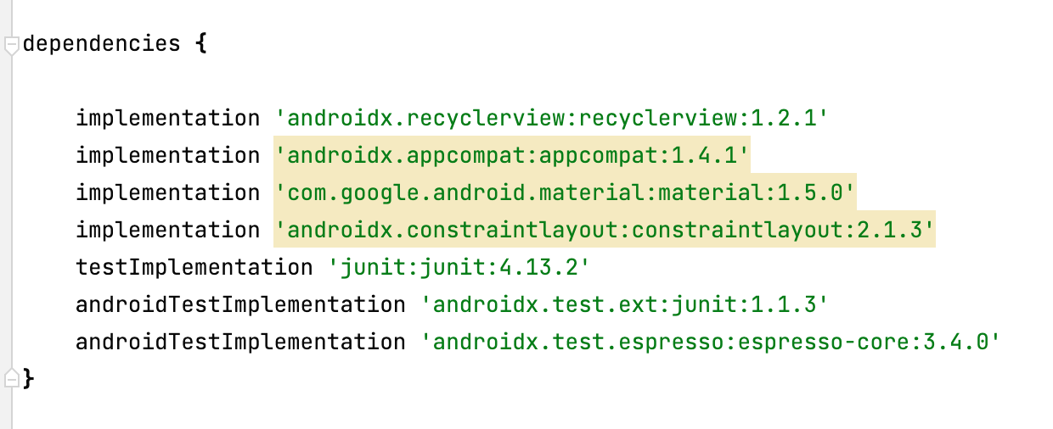
Implementation
Add RecyclerView library to build.gradle
androidx.recyclerview:recyclerview:1.2.1

Slide 14
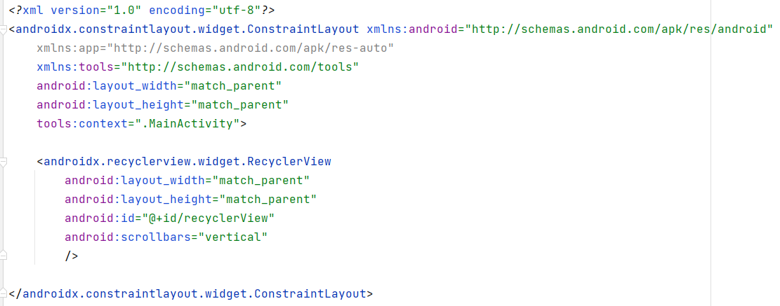
Implementation
Add RecyclerView to main layout

Slide 15
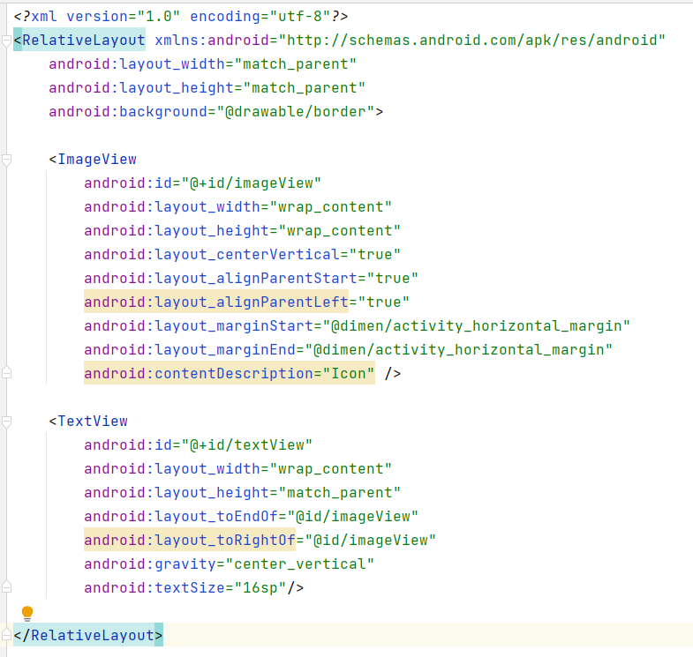
Implementation
Create XML layout for item

Slide 16
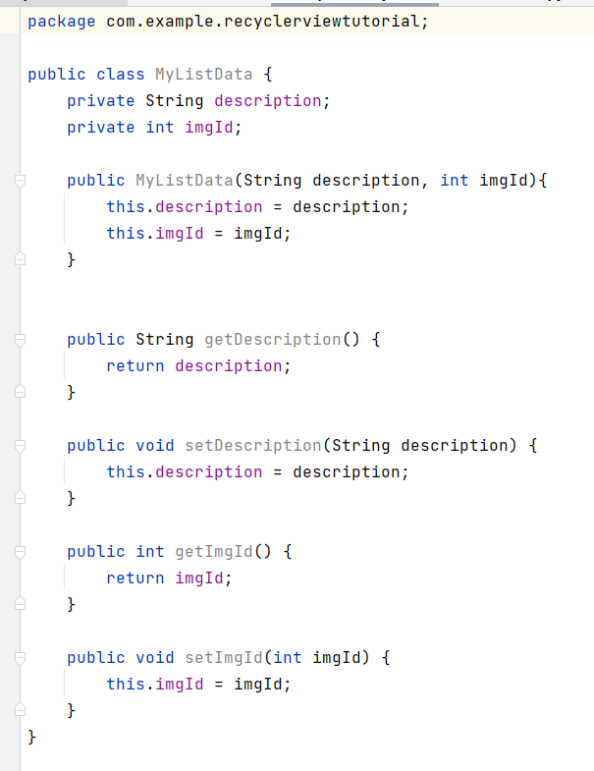
Implementation
Create data class

Slide 17
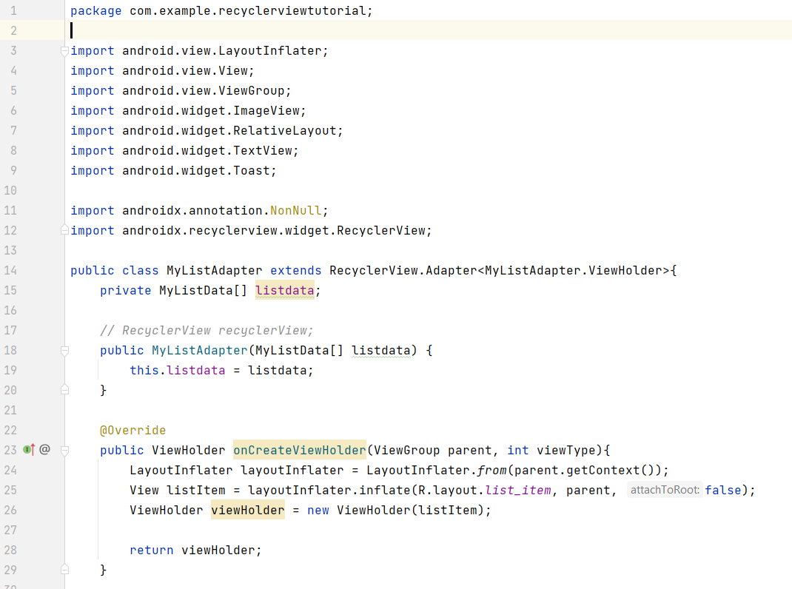
Implementation
Create Adapter class

Slide 18
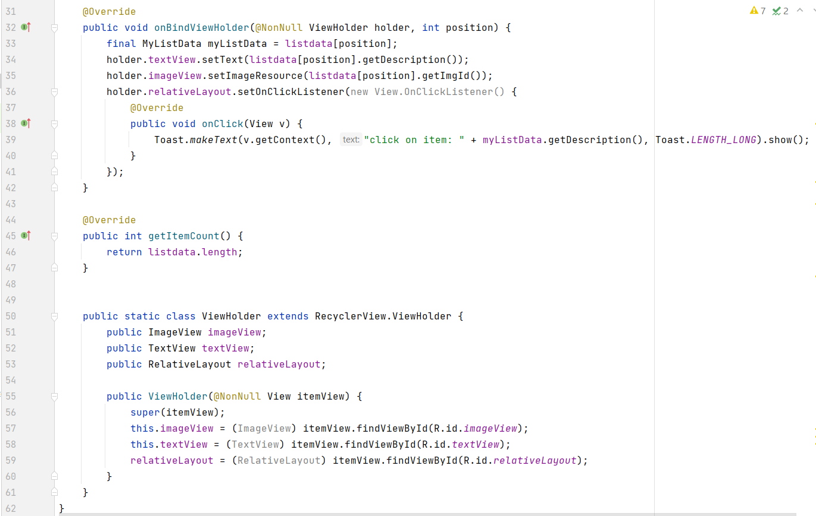
Implementation
Create Adapter class

Slide 19
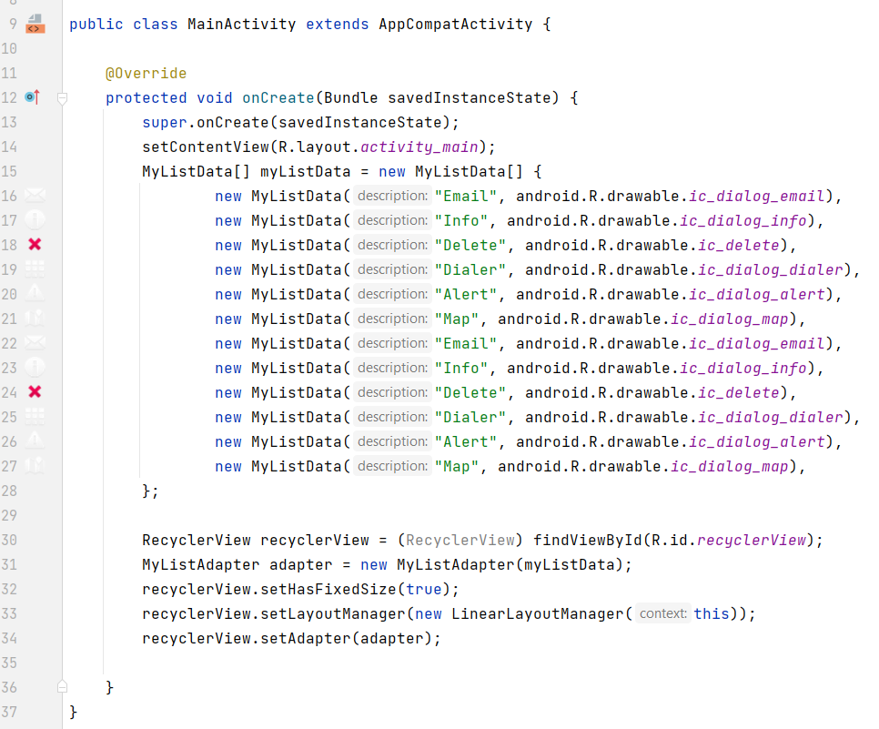
Implementation
Add RecyclerView to MainActivity

Slide 20
References
Head First Android Development. A Brain friendy guide. Dawn Griffiths and David Griffiths.O’reilly. ISBN:978-1-449-36218-8. Chapter 13
https://developer.android.com/develop/ui/views/layout/recyclerview
https://www.javatpoint.com/android-recyclerview-list-example
https://www.geeksforgeeks.org/android-recyclerview/

